Slide 1
Accelerator Program In Business Analytics And Data Science: Batch 7 G4 – Capstone Project
Group 4 Participants: 1) Vrushabh Dongre
2) Satya Spandana
3) Ganesh Prakash Shet

Slide 2
Analyses of Retail Sales Case Study

Slide 3
scenario
You have been given a dataset from a leading retail giant. The dataset contains information on
Demographics of the customers.
Purchase Behavior.
Response to various marketing campaigns run.

Slide 4
Using the steps in the CRISP- DM methodology to Break down the business level problem to analytical solution.
Steps involved in CRISP- DM methodology.
Business Understanding
Data Understanding
Data Preparation
Data Analysis in Python.
Report (PPT)

Slide 5
Business Understanding

Slide 6
Business Objective
The retailer wants to understand “what kind of customers respond to different campaigns”
To achieve reasonable answer to the above Objective, we've been tasked to analyze this dataset.
Some pointed business questions that we are required to answer.

Slide 7
Data Understanding

Slide 8
Dataset Overview
The dataset contain Three essential files:
Demographics.Txt: Contains granular details on customer demographics.
Behaviour.Json: Provides insightful data regarding customer purchase behavior.
Campaign.Json: Offers valuable insights into customer response patterns to marketing campaigns.

Slide 9
Demographics Dataset
ID :- Customer's unique identifier
Year_Birth :- Customer's birth year
Education :- Customer's education level
Marital_Status :- Customer's marital status
Income :- Customer's yearly household income
Kidhome :- Number of children in customer's household
Teenhome :- Number of teenagers in customer's household
Dt_Customer :- Date of customer's enrollment with the company
Country :- Customer's location

Slide 10
Behavior Dataset
Recency :- Number of days since customer's last purchase
MntWines :- Amount spent on wine in the last 2 years
MntFruits :- Amount spent on fruits in the last 2 years
MntMeatProducts :- Amount spent on meat in the last 2 years
MntFishProducts :- Amount spent on fish in the last 2 years
MntSweetProducts :- Amount spent on sweets in the last 2 years
MntGoldProducst :- Amount spent on gold in the last 2 years
NumDealsPurchases :- Number of purchases made with a discount
NumWebPurchases :- Number of purchases made through the company's web site
NumCataloguePurchases :- Number of purchases made using a catalogue
NumStorePurchases :- Number of purchases made directly in stores
NumWebVisitsMonth :- Number of visits to company's web site in the last month

Slide 11
Campaign Dataset
AcceptedCmp1 :- 1 if customer accepted the offer in the 1rd campaign, 0 otherwise
AcceptedCmp2 :- 1 if customer accepted the offer in the 2th campaign, 0 otherwise
AcceptedCmp3 :- 1 if customer accepted the offer in the 3th campaign, 0 otherwise
AcceptedCmp4 :- 1 if customer accepted the offer in the 4st campaign, 0 otherwise
AcceptedCmp5 :- 1 if customer accepted the offer in the 5nd campaign, 0 otherwise
Response :- 1 if customer accepted the offer in the last campaign, 0 otherwise
Complain :- 1 if customer complained in the last 2 years, 0 otherwise

Slide 12
Data Preparation

Slide 13
Data Quality and Check (Task 1)
Create a consolidated view of data by joining the data present in three files.

Slide 14
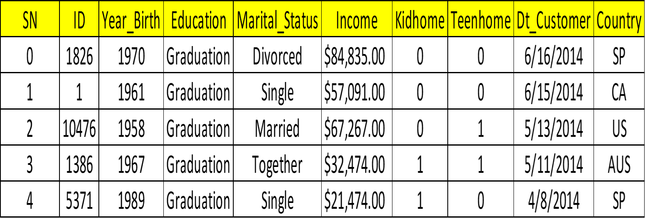
Loading Demographics Dataset

Slide 15
Looking into demographic's information
demog.info()

Slide 16
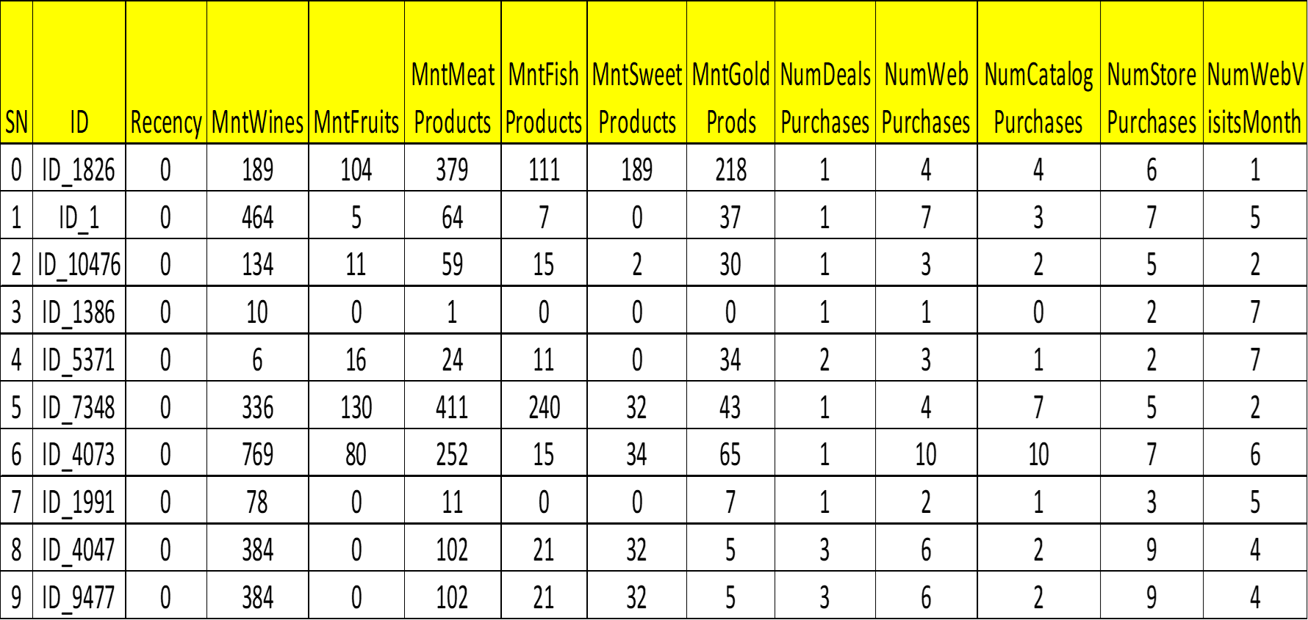
Loading Behavior Dataset

Slide 17
Looking into Behaviour’s Information behav.info()

Slide 18
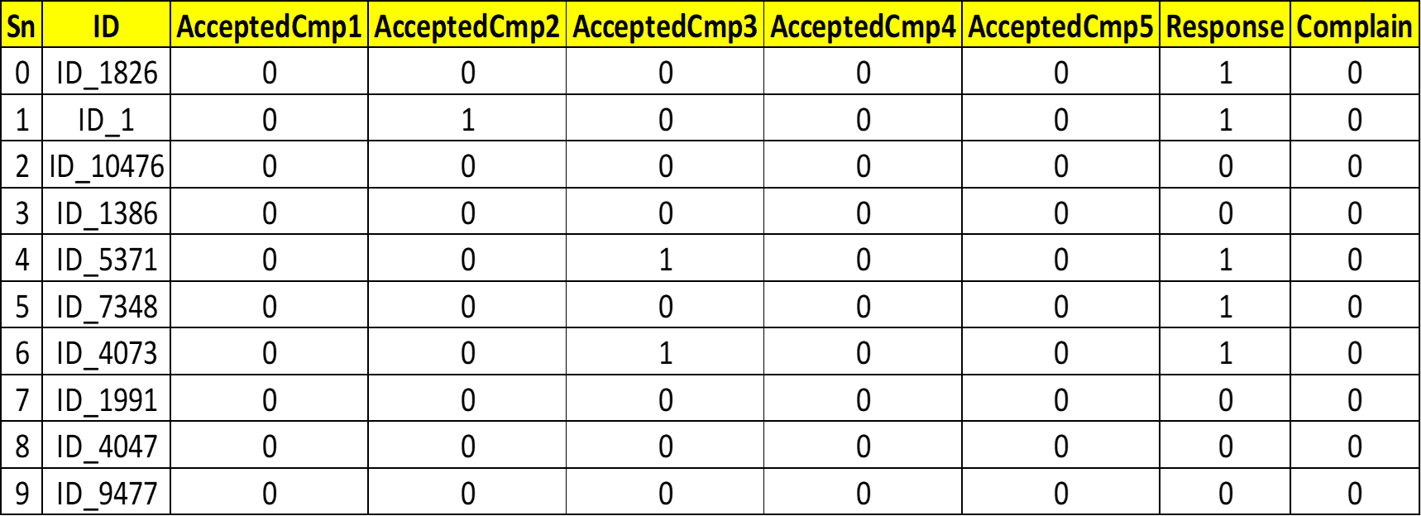
Loading Campaign Dataset

Slide 19
Looking into Campaign's information campa.info()

Slide 20
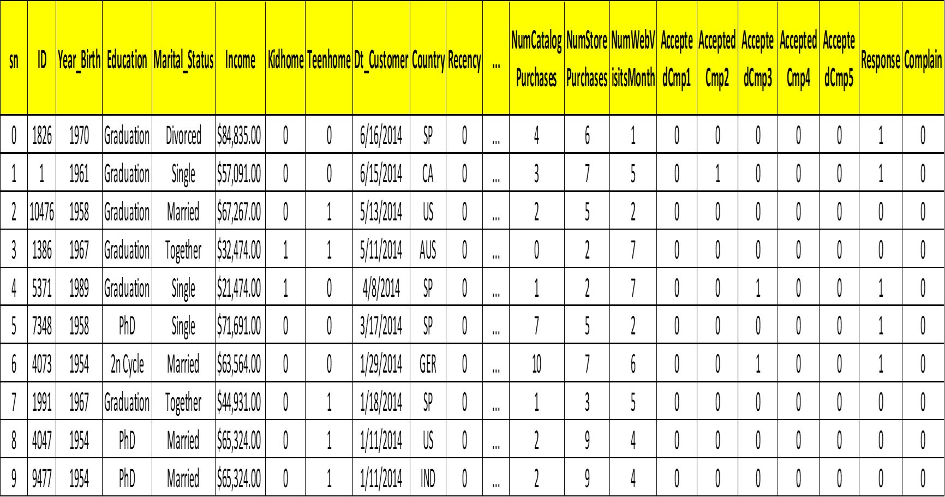
Merging all three tables and named it Merged_df for consolidated view of data

Slide 21
Looking into Merged Table's information merged_df.info()

Slide 22
observation
Income:
The Income column name has space in it so removing space in that and renaming it.
The $ sign should be removed also with commas and spaces in the values.
The data type should be changed to integer type for analysis purpose
Null values present in the column.
Dt_Customer: The data type of this date column has to be converted into datetime type.

Slide 23
Data Quality Report

Slide 24
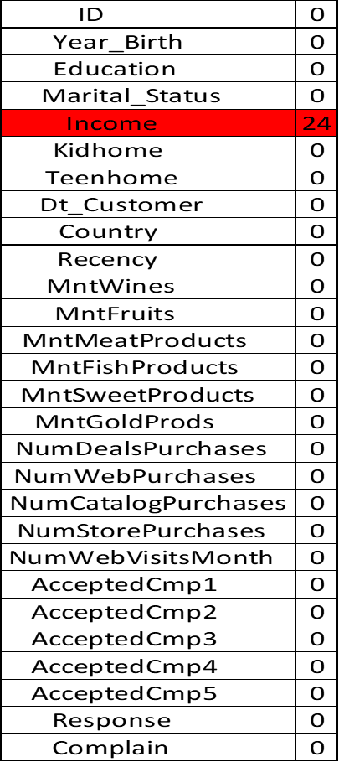
# Calculating null values:

Slide 25
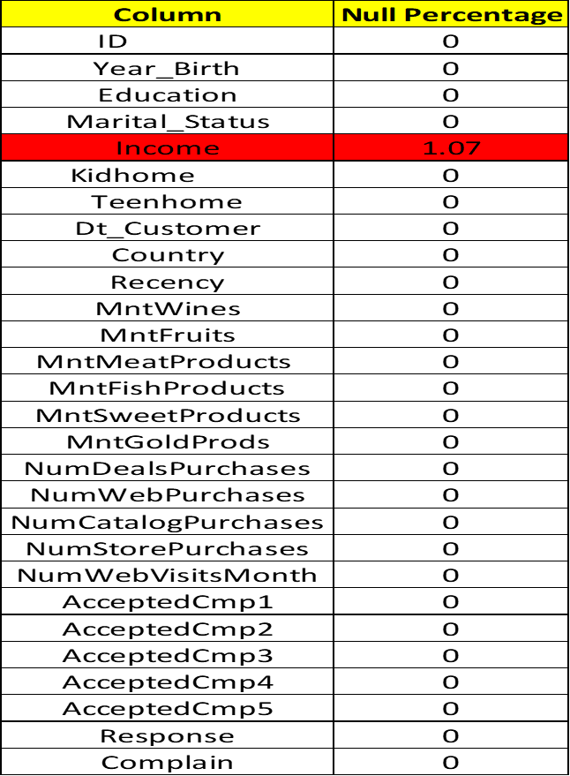
# Percentage of null values:

Slide 26
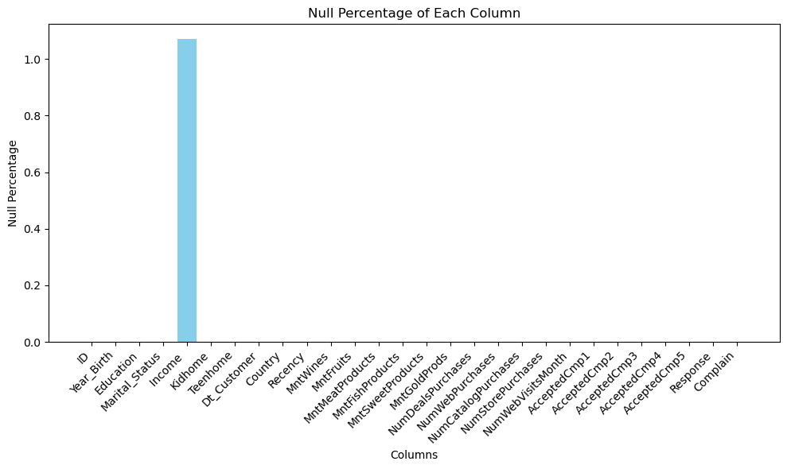
Visualizing Proportion of Null Values in the Dataset

Slide 27
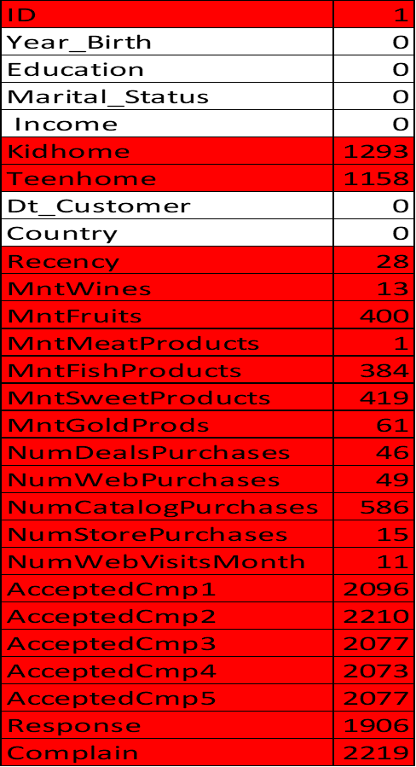
Number of Zero Values

Slide 28
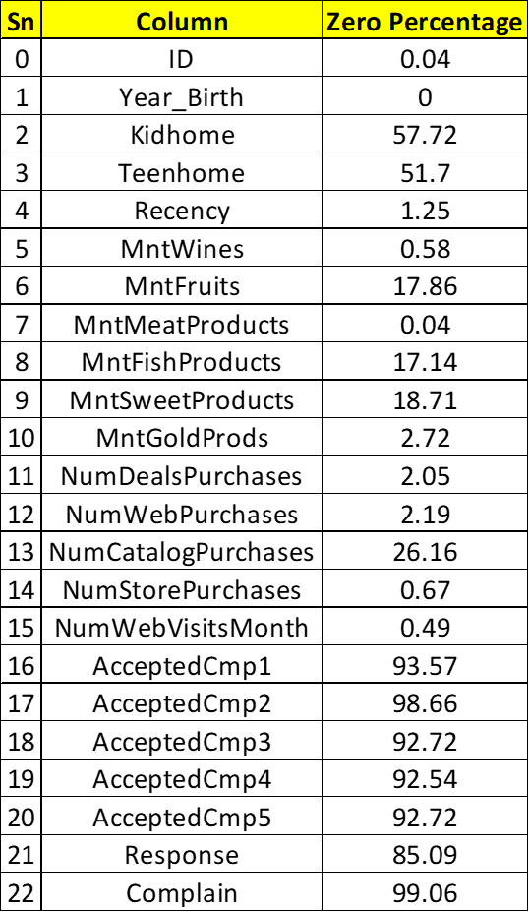
Percentage of Zero Values

Slide 29
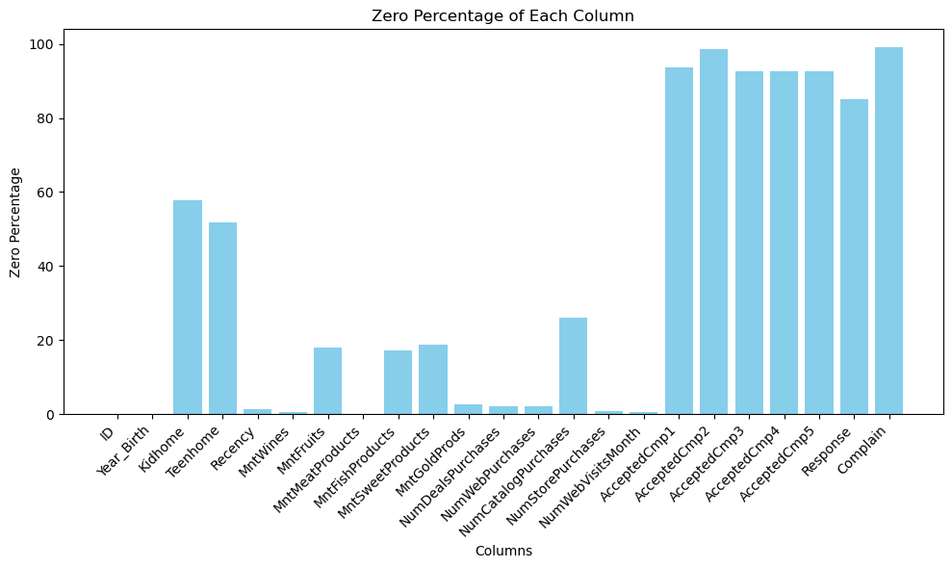
Visualizing Proportion of Zero Values in the Dataset

Slide 30
Looking at Merged Data information after Data cleaning and preprocessing

Slide 31
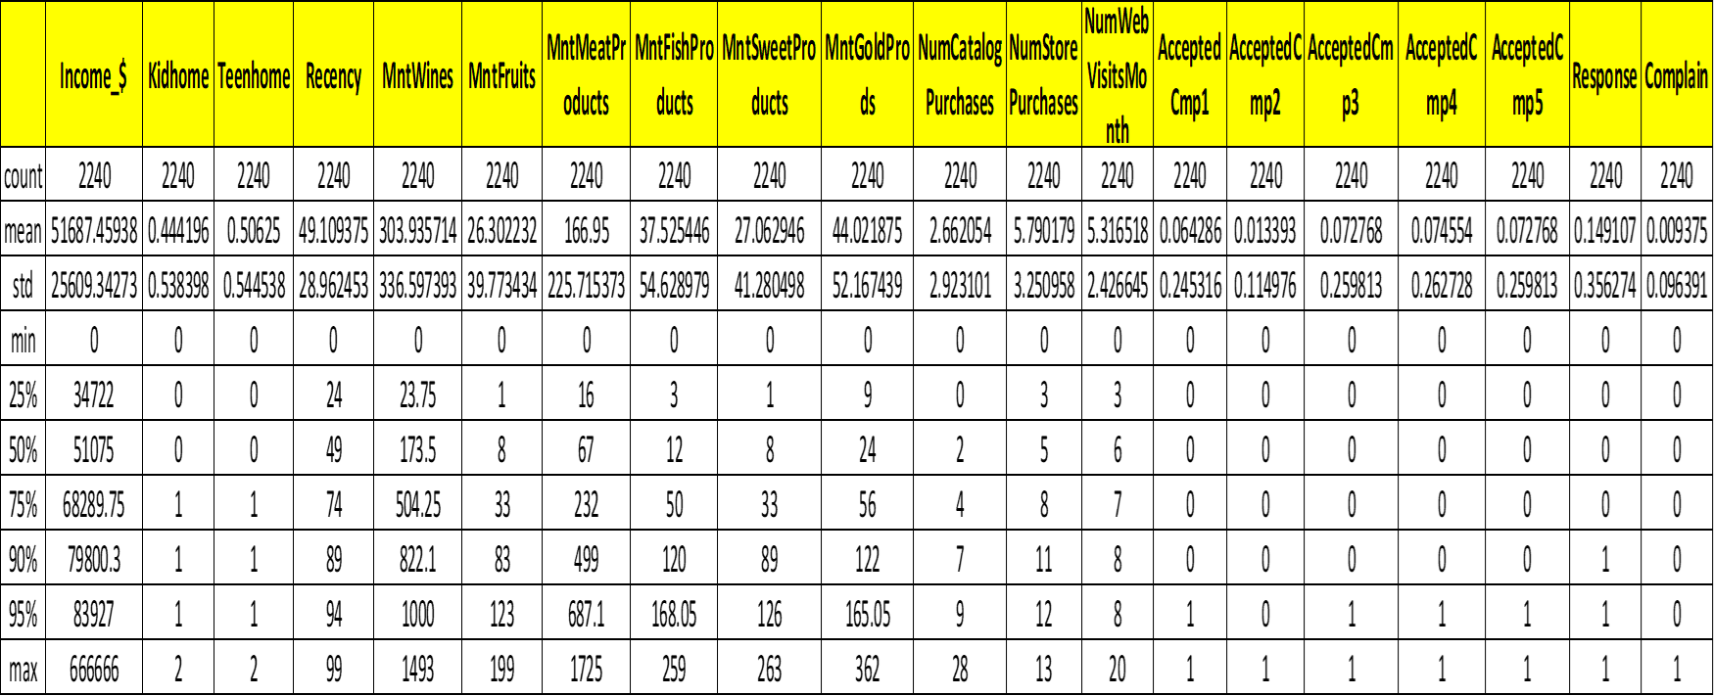
Univariates for continuous variables (mean, 25th, 50th, 75th, 90th and 95th percentile, min and max)

Slide 32
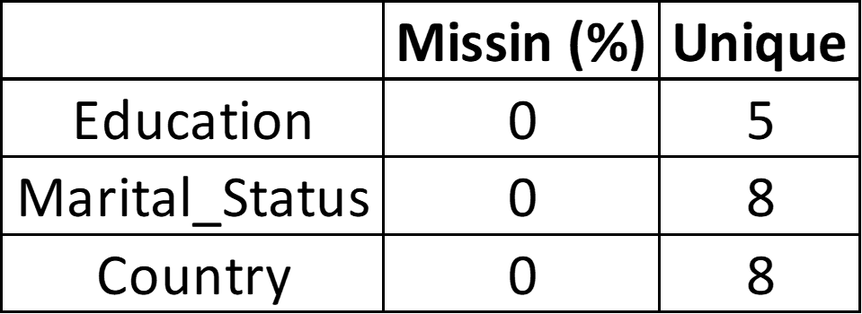
# Display the categorical statistics: categorical_stats

Slide 33
Display the DataFrame containing outliers outliers_df

Slide 34
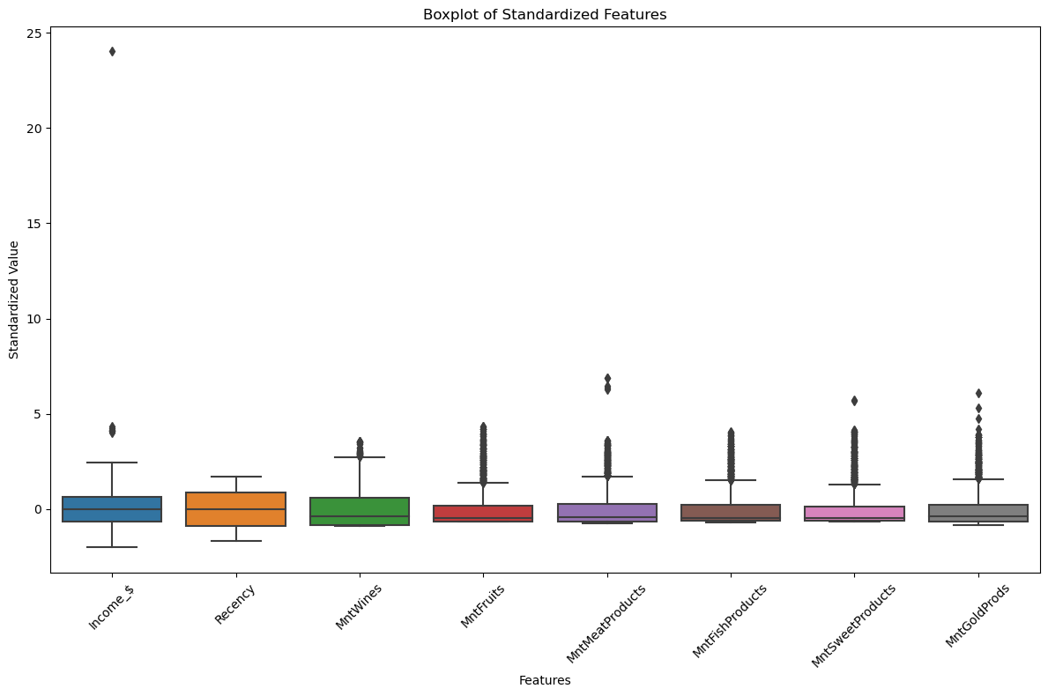
Plotting Box Plot

Slide 35
# Display the DataFrame containing outliers count outliers_count_df

Slide 36
Business Analysis and Hypothesis (Task 2)
Generate and check hypothesis around Amount Spent on different categories and response rate in different marketing campaigns

Slide 37
Defining a function “conduct_ttests” to conduct T-tests.
Hypothesis testing, such as the t-test, is a statistical method to assess if there's a significant difference between the means of two groups. It helps determine if sample means are statistically different, assuming the samples are drawn from populations with normal distributions.

Slide 38
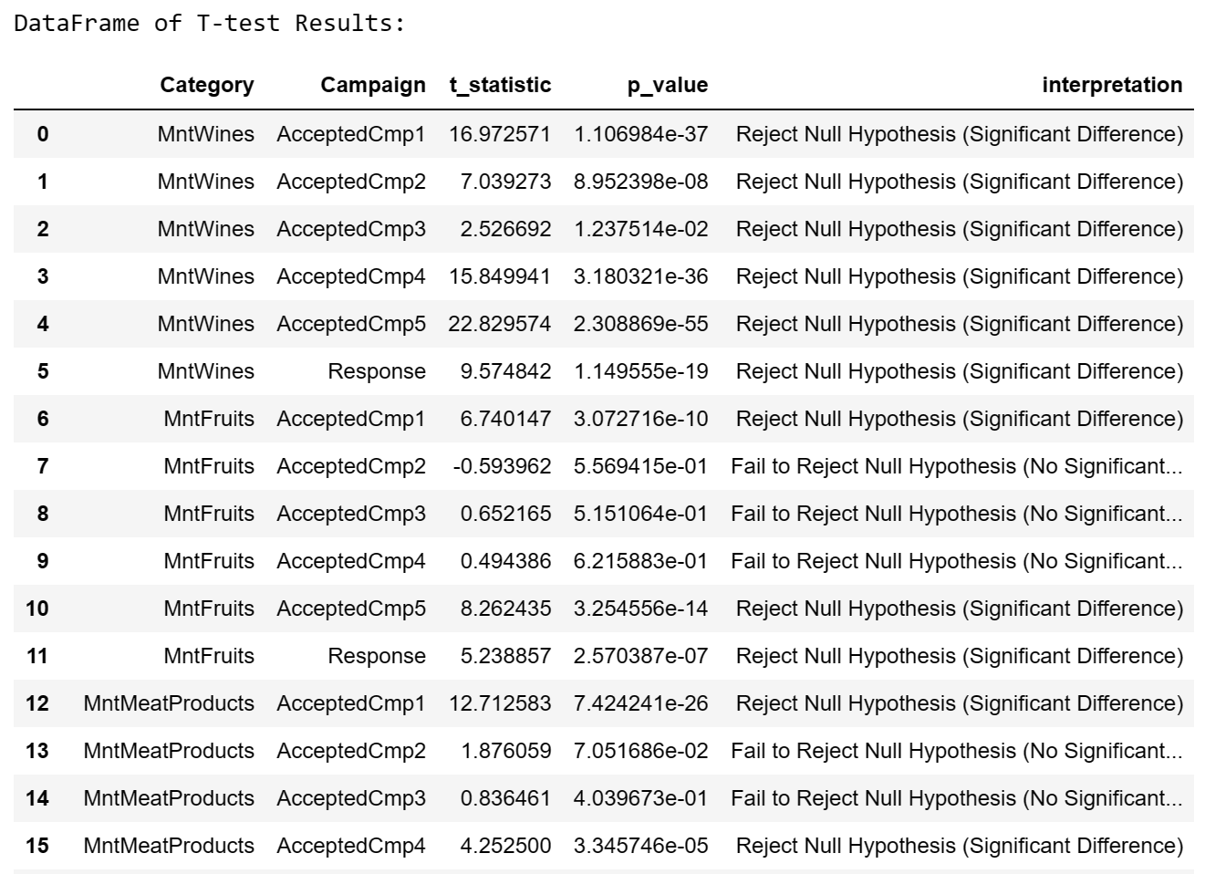
After conducting T-test, the Data frame of T-test Results:

Slide 39
Creating a funnel analysis showing what percentage of unique customers accept campaign 1,2, 3,..etc
Count of Unique customers in each category :-
AcceptedCmp1 - 144
AcceptedCmp2 -17
AcceptedCmp3 - 135
AcceptedCmp4 - 108
AcceptedCmp5 - 59
Response - 146

Slide 40
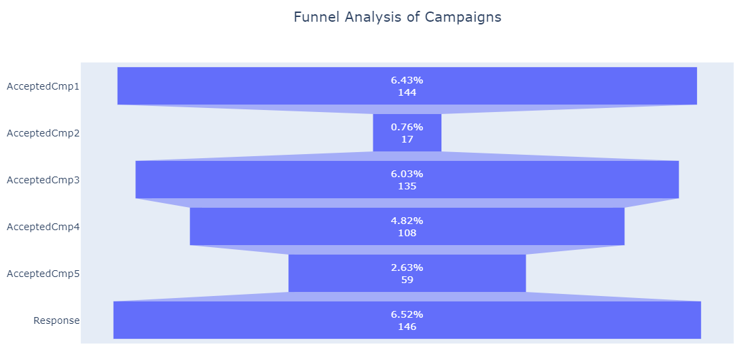

Slide 41
Insights from the visualization :
Campaigns 1,3 and Response have relatively higher counts compared to the other campaigns, indicating stronger customer engagement with these campaigns.
Campaigns 2, 4 and Campaigns 5 have lower counts, suggesting lower levels of customer response or acceptance to these particular campaigns.
Response has the highest count among all stages, indicating a significant number of customers responded positively to the final campaign.

Slide 42
The impact of the income on the amount spent on - Wine - Meat Products - Gold Products - Fish Products
Process done :
Removing the outlier values from Income column for better analysis.
Grouping the data by income bins.
Visualizing the data using Bar graph.

Slide 43
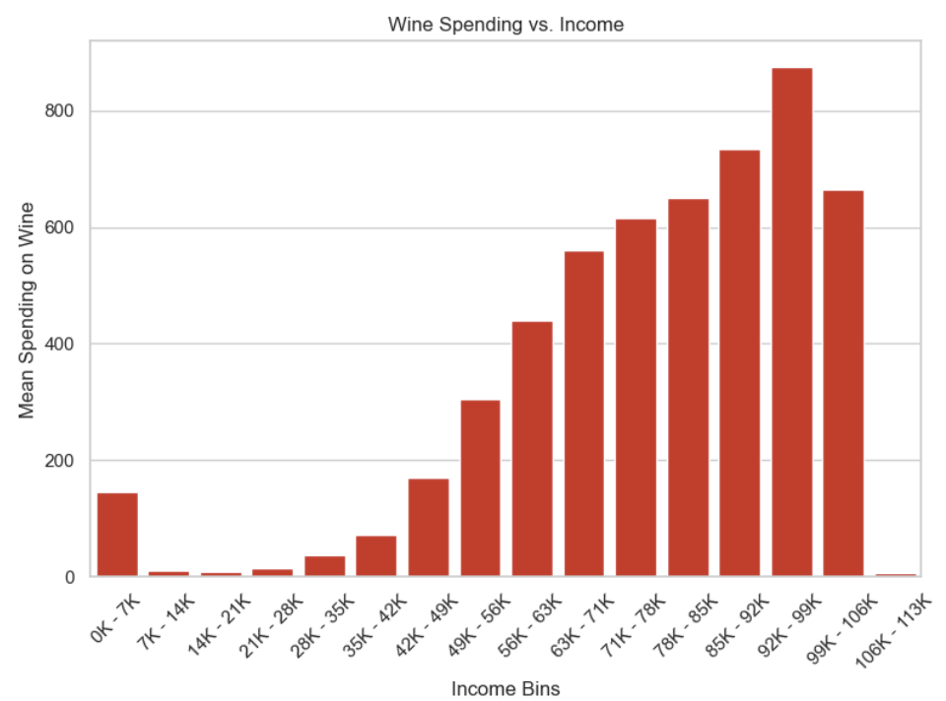
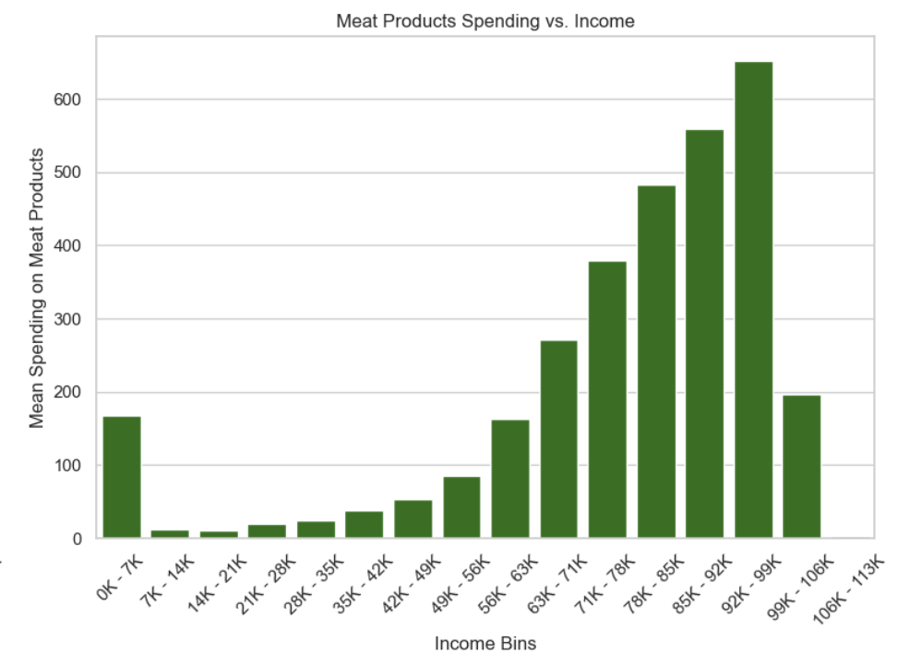

Slide 44
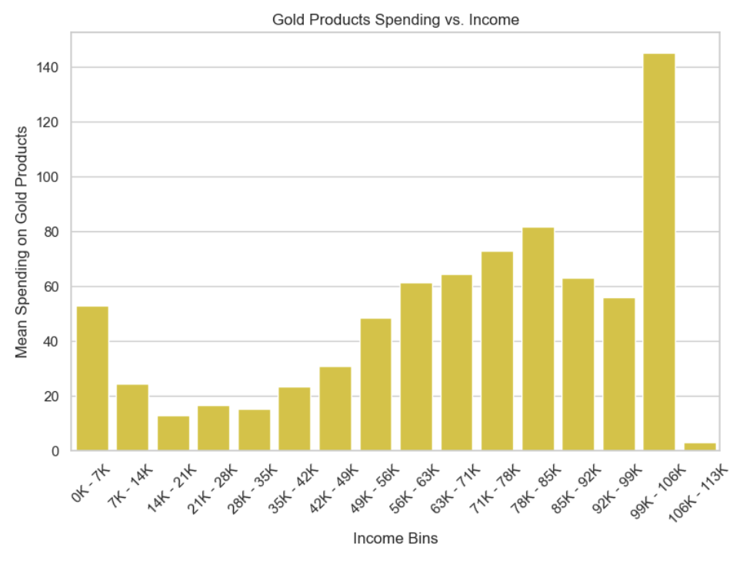
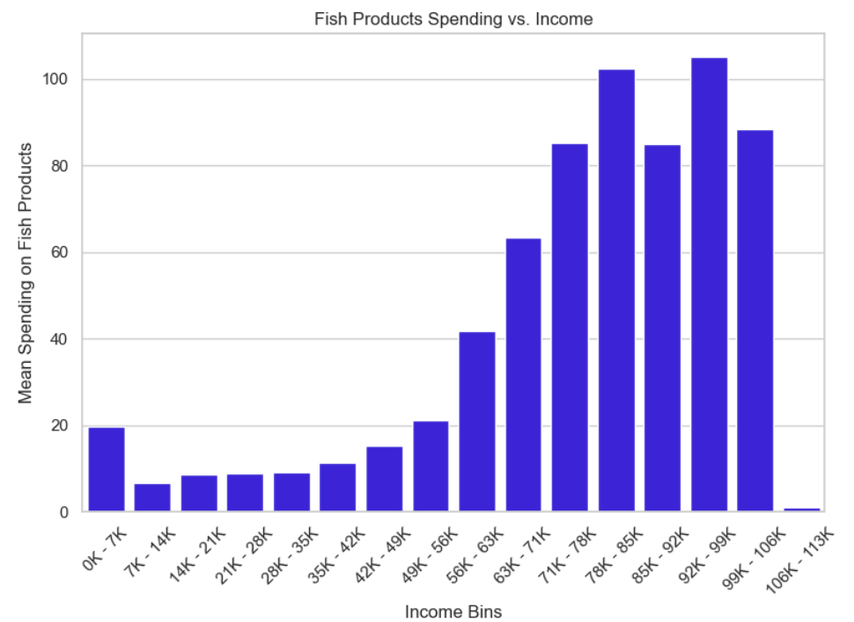

Slide 45
Insights from the visualization :
Positive Correlation Between Income and Spending: Generally, as income increases, customers tend to spend more on wines, meat products, and gold products. This trend is evident from the increasing expenditure observed in higher income brackets.
Unique Spending Behavior for Gold Products: While spending on most items increases with income, the relationship is more nuanced for gold products. There's a peak in spending around the middle-income range, followed by a slight decrease in higher income brackets. This suggests that while gold products are desirable across income groups, they may be perceived differently or serve varying purposes based on income levels.
Varied Spending Patterns for Fish Products: Unlike other items, spending on fish products shows less consistent patterns across income groups. While there's a general increase in spending with income, fluctuations and inconsistencies are observed, indicating that factors other than income may influence spending behavior for fish products.

Slide 46
Testing of hypothesis that recent customers complain less in general compared to older customers
We are using the chi-square test for independence to examine the relationship between two categorical variables: customer recency and customer complaints. The chi-square test will help us determine if there is a significant association between these two variables. In this case, we want to investigate whether recent customers tend to complain less compared to older customers. By conducting a chi-square test, we can assess whether there is evidence to reject the null hypothesis, which states that there is no association between recency and complaints. If the test results in a low p-value, we can conclude that there is a significant difference in complaint rates between recent and older customers, providing valuable insights into customer behavior.

Slide 47
Importing chi square test :
from scipy.stats import chi2_contingency
Calculating mean for Old vs New Customer Complain
After performing chi-square test of independence,
Complaint rate for recent customers – 0.01
Complaint rate for older customers – 0.01
Chi-square statistics – 0.00
P-value : 1.000
There is no significance between recency and complaint status.

Slide 48
Do people who accept the offer in the first campaign also accept in any other campaign?
Campaign acceptance details :
Proportions of acceptance in subsequent campaigns among those who accepted the first campaign:
Accepted cmp2 : 0.09
Accepted cmp3 : 0.17
Accepted cmp4 : 0.33
Accepted cmp5 : 0.47
Response : 0.55

Slide 49
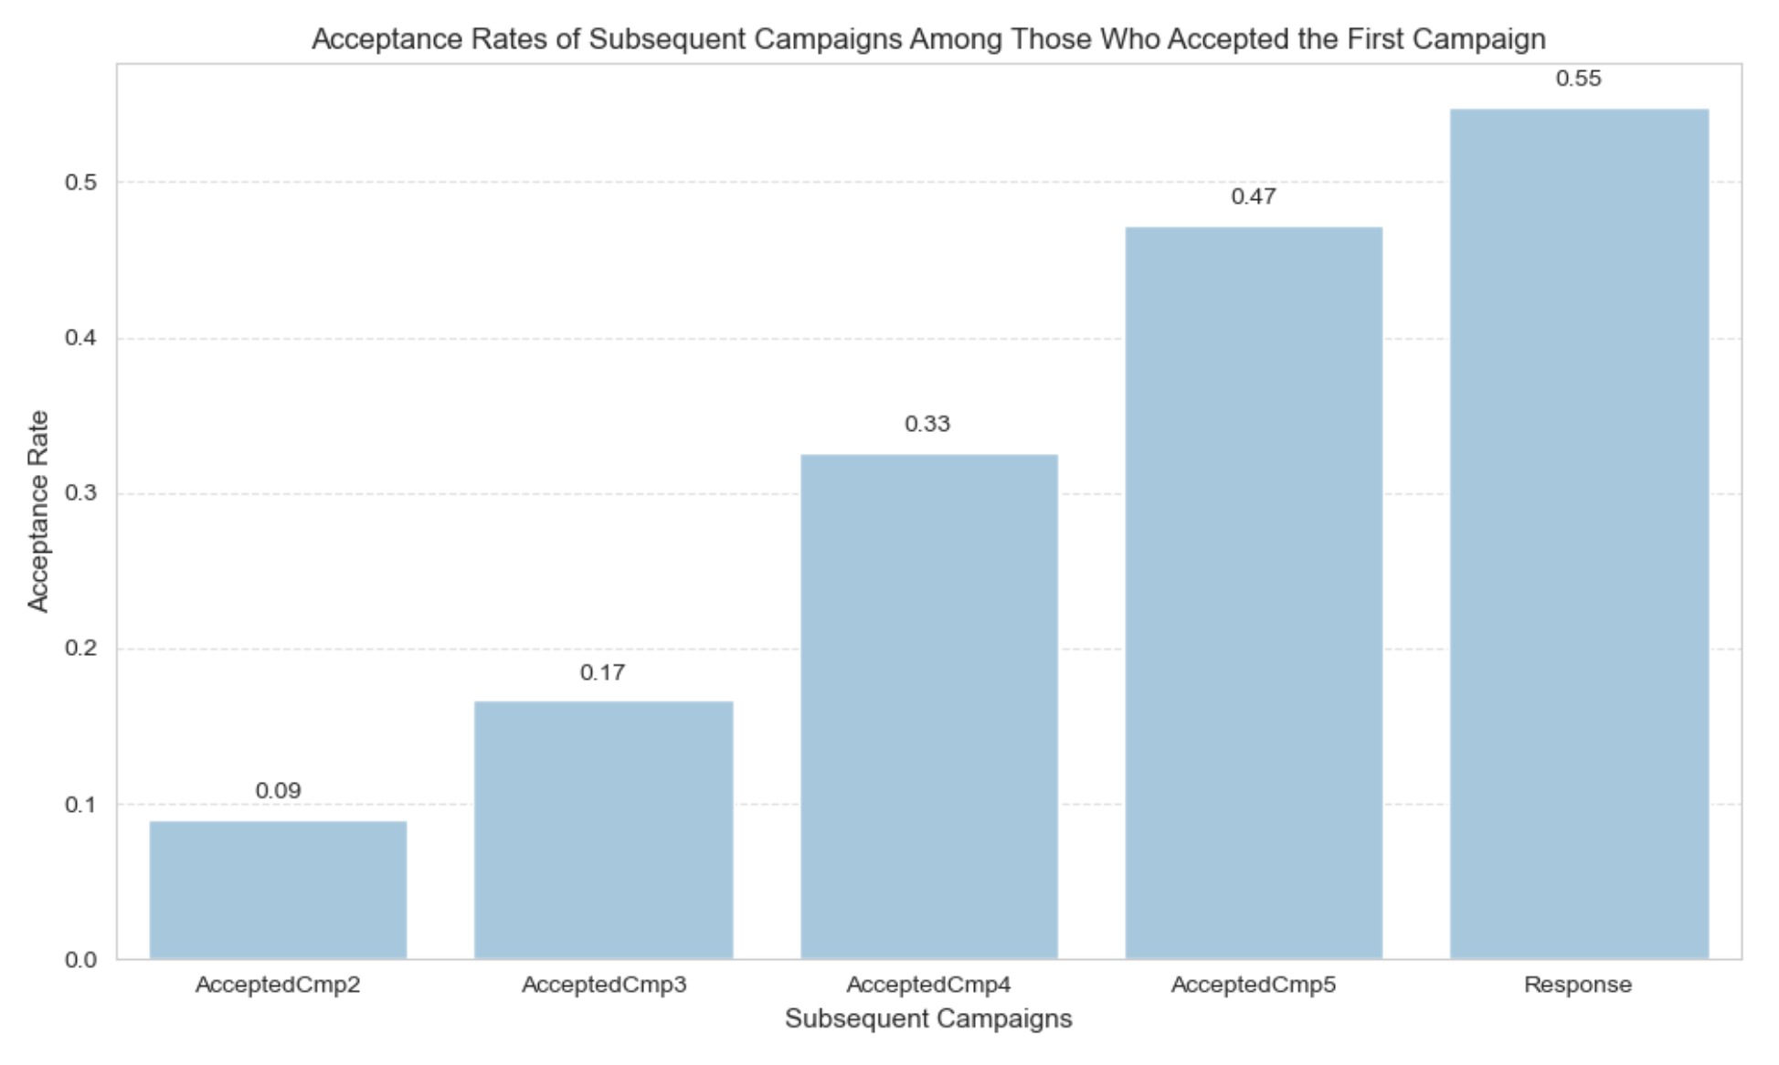

Slide 50
Insights :
Increasing Acceptance Rates Across Campaigns: There is a notable trend of increasing acceptance rates in subsequent campaigns among those who accepted the first campaign. The proportion of acceptance steadily rises from AcceptedCmp2 to Response, indicating a positive response escalation over multiple campaigns.
Significant Jump in Response Rate: The most significant jump in acceptance rate occurs between AcceptedCmp4 and AcceptedCmp5, with the proportion increasing from 0.33 to 0.47. This suggests that the fourth and fifth campaigns may have been particularly effective in engaging customers who responded positively to the initial campaign.
High Response Rate for Final Campaign: The Response campaign exhibits the highest acceptance rate at 0.55, indicating that a significant portion of customers who responded to the first campaign continued to engage with subsequent campaigns, ultimately resulting in a favorable response to the final campaign.

Slide 51
Profile of people who respond vs. who don’t.
Removing outlier values from Income and Year_Birth columns for better analysis.
Splitting dataset into Responders vs Non-Responders and Look at Stats
Defining charts for each group i.e., Numerical and Categorical.
Histogram : A Histogram is a visual representation of data distribution, displaying the frequency of values within predefined intervals or bins. It provides insights into the spread and shape of the data. In python, histograms are commonly created using libraries like matplotlib, where the hist() function is used to plot the data. Histograms are essential for analyzing and understanding of numerical data.
Column chart : A column chart in python is a visual representation of data using vertical bars, where the height of each bar corresponds to the data being represented. It is a common way to compare categories or show trends in data. In python, column charts can be created using libraries like Matplotlib or seaborn, providing a clear and effective way to visualize and analyze data.

Slide 52
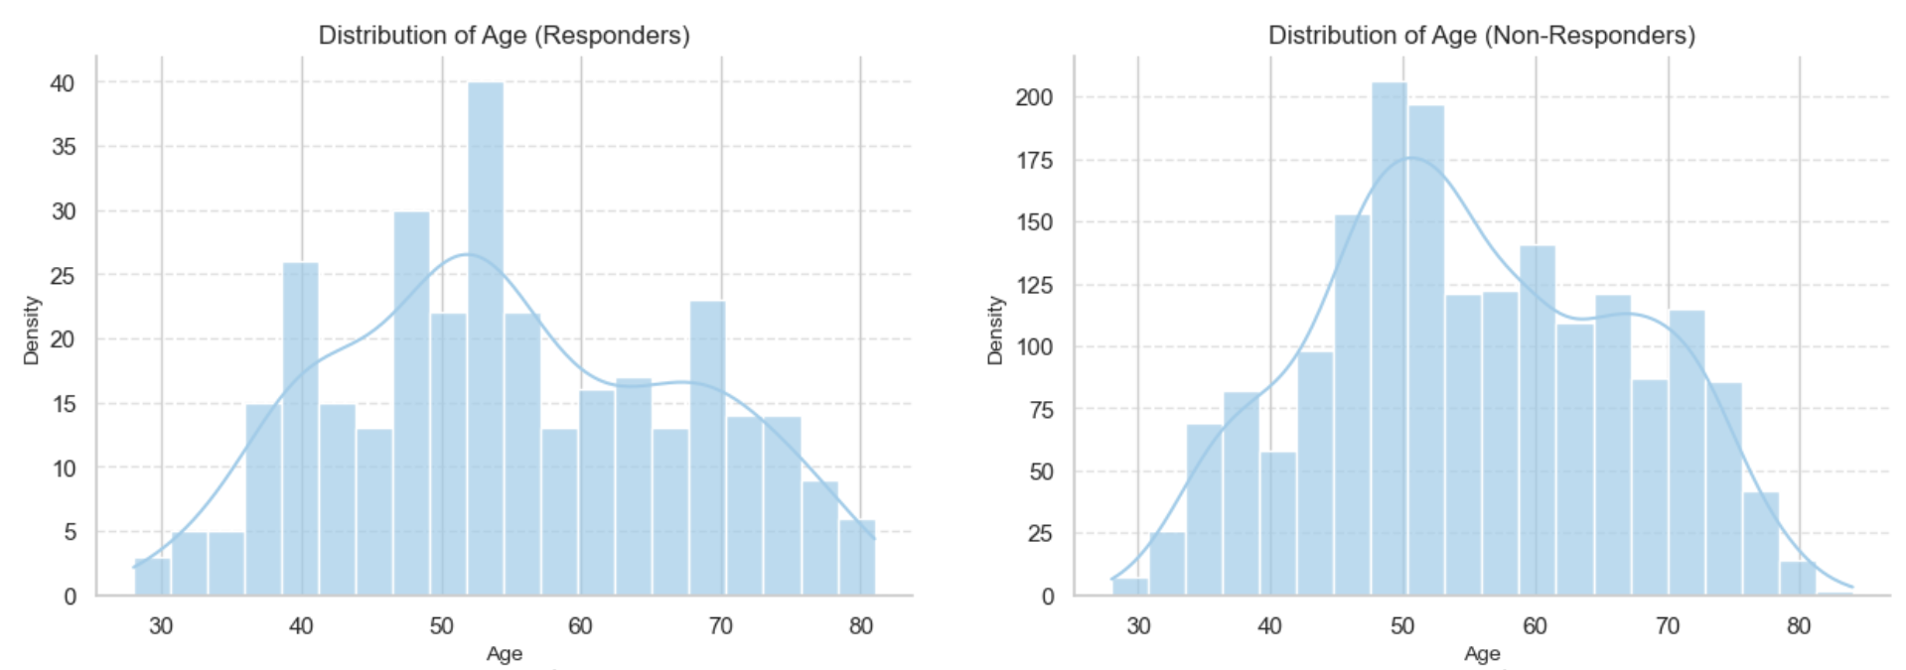
Year of Birth:
Responders:
The majority of responders were born between 1970 and 1985, peaking around the early 1970s to mid-1980s. The mean birth year is approximately 1969, indicating that the bulk of responders are in their mid-30s to early 50s.
Non-Responders:
Non-responders, on the other hand, have a similar distribution, with the highest concentration between 1972 and 1979 i.e. mid 40s to 50s. The mean age is around 55, suggesting that non-responders are slightly older on average compared to responders.

Slide 53
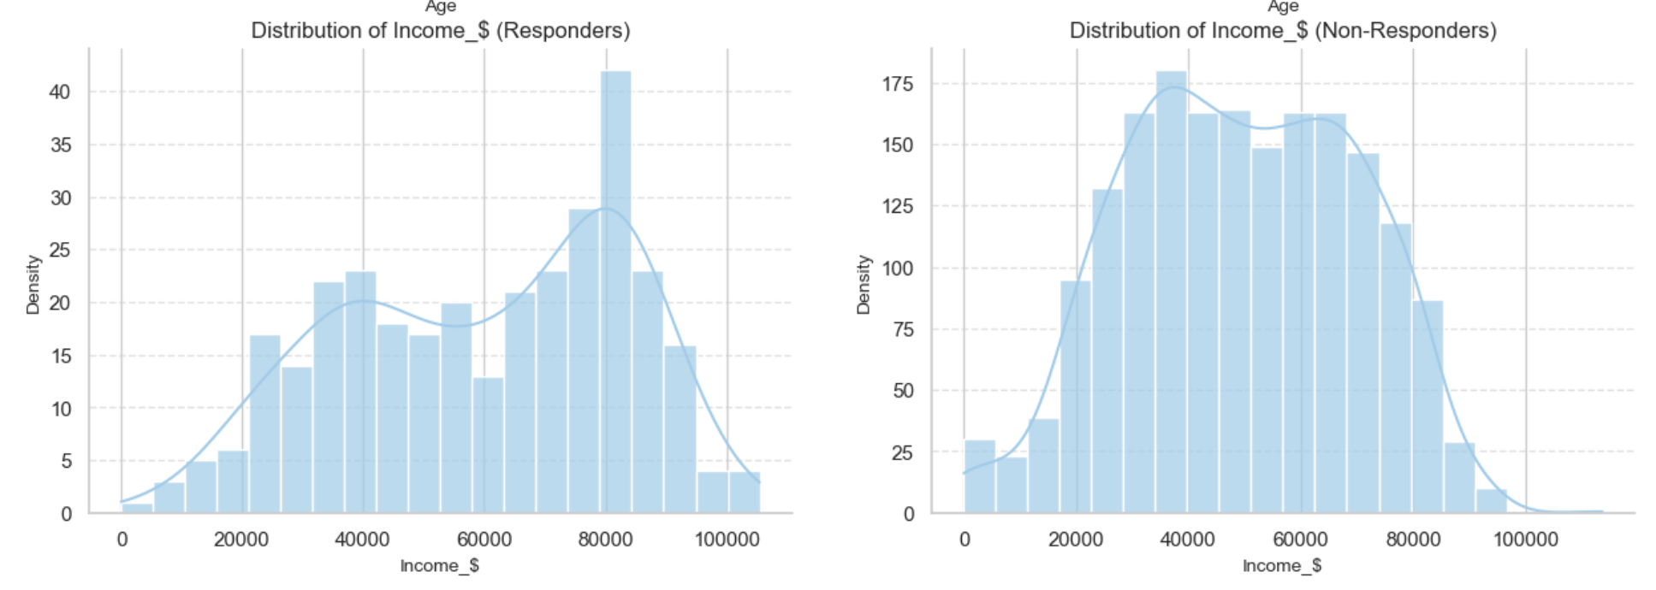
Income:
Responders:
Responders have a higher mean income (60,029.41) compared to non-responders (49,486.49). Most responders fall within the income bracket of 40,000 to 80,000, with fluctuations and the highest concentration between 78,000 and 82,000.
Non-Responders:
Non-responders are generally in a lower income bracket, with most falling within the range of 30,000 to 78,000. Unlike responders, there are no significant fluctuations in income distribution among non-responders.

Slide 54
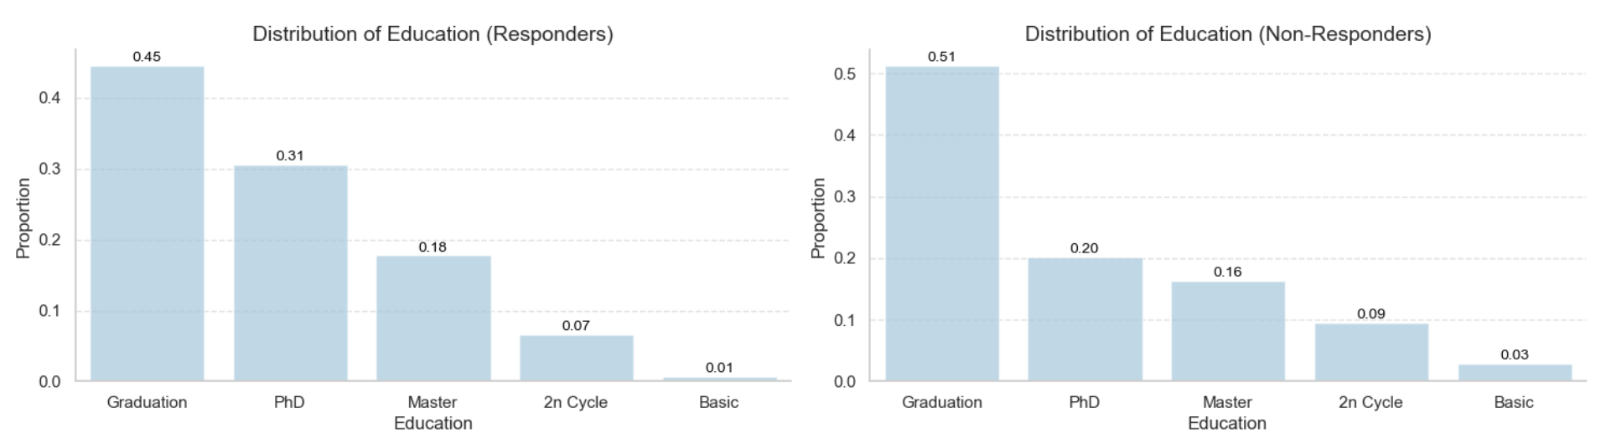
Education:
Responders:
Among responders, Graduation is the most prevalent education level, with nearly half of the responders having this qualification. This is followed by Phd, Master, and 2n Cycle, indicating a relatively high level of education among this group.
Non-Responders:
Non-responders exhibit a similar educational distribution, with Graduation being the most common education level, followed by Phd, Master, and 2n Cycle.

Slide 55
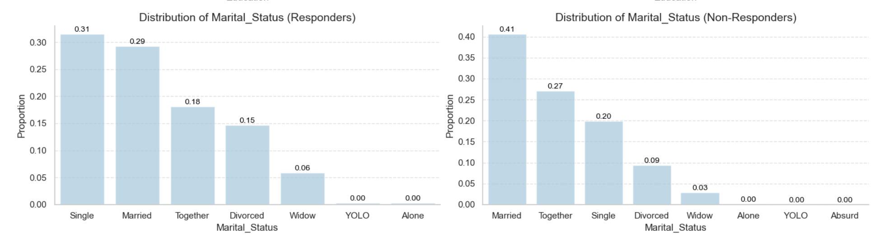
Marital Status:
Responders:
The majority of responders are Single, comprising around one-third of the group. This is followed by Married, which accounts for a significant portion of responders.
Non-Responders:
In contrast, non-responders are more likely to be Married, with over one-third of the group falling into this category. Single individuals also make up a substantial portion of non-responders.

Slide 56
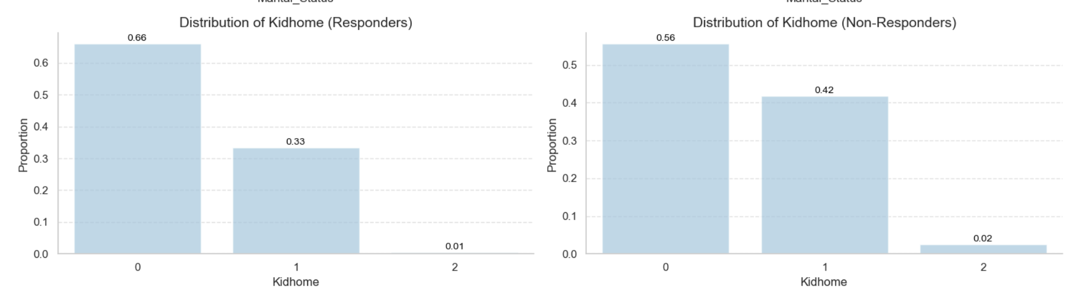
Household Composition:
Responders:
The majority of responders have no children at home (Kidhome = 0), followed by one child (Kidhome = 1), and two children (Kidhome = 2). This suggests that a significant portion of responders may be younger adults or individuals without children.
Non-Responders:
Non-responders exhibit a similar household composition, with most having no children at home, followed by one child, and two children.

Slide 57
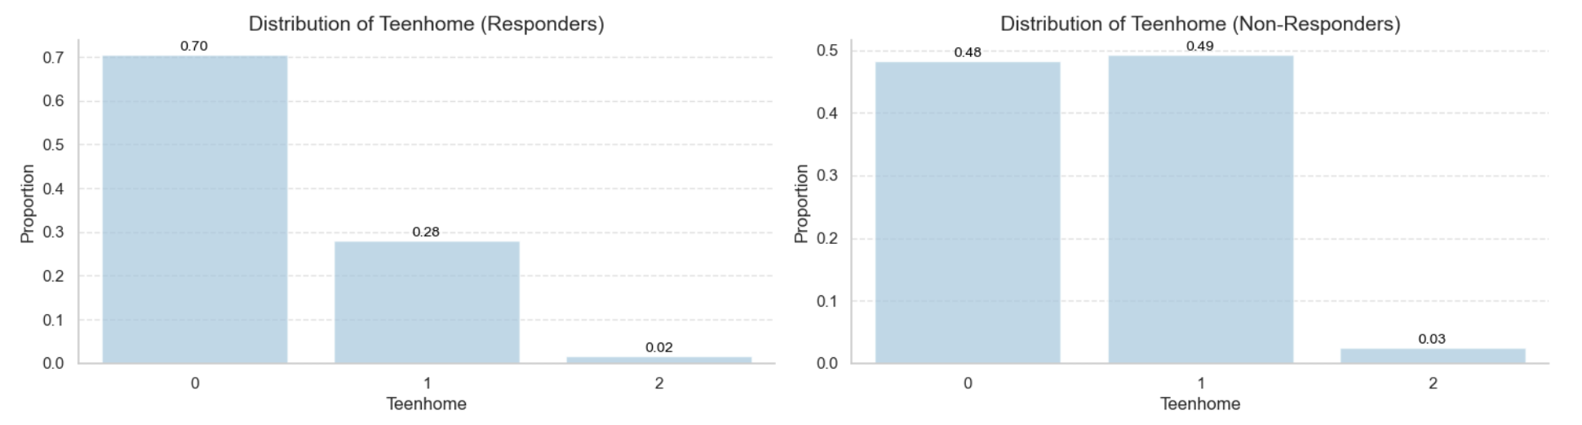
Teenagers at Home:
Responders:
Most responders have no teenagers at home (Teenhome = 0), followed by one teenager (Teenhome = 1), and two teenagers (Teenhome = 2). This indicates that the majority of responders may not have teenage children.
Non-Responders:
In contrast, non-responders are more likely to have one teenager at home, followed by no teenagers, and two teenagers. This suggests that non-responders may have a higher likelihood of having teenage children.

Slide 58
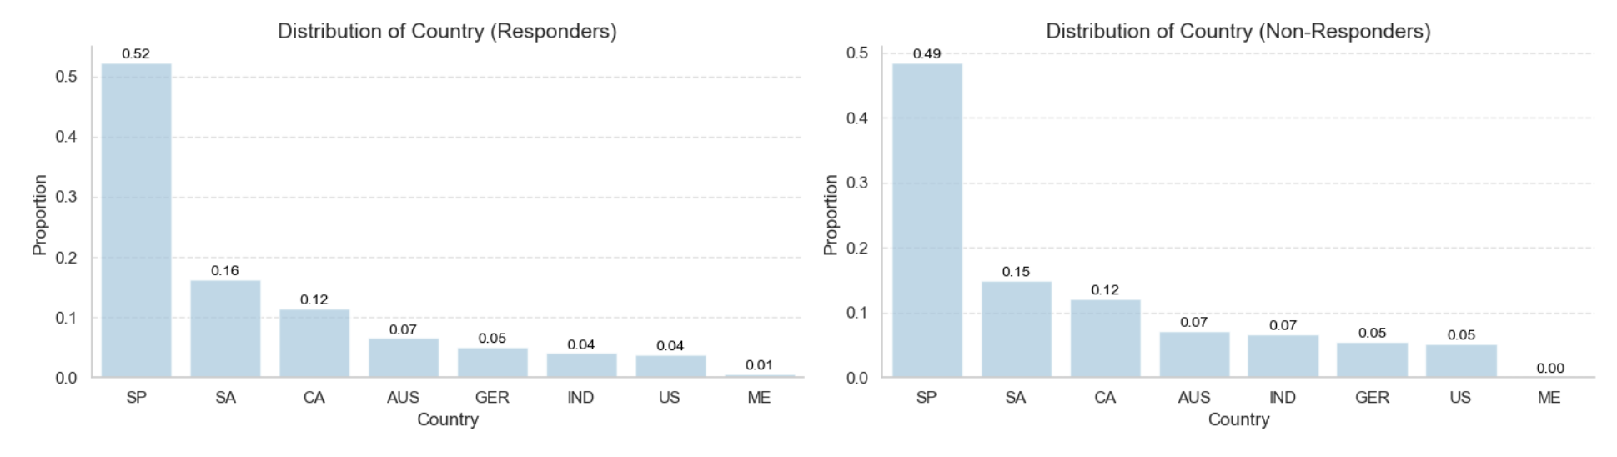
Country:
Responders:
The highest number of responders are from Spain (SP), followed by SA, CA, AUS, and GER. This distribution reflects the geographic distribution of responders, with Spain being the most prevalent country.
Non-Responders:
Similarly, the highest number of non-responders are from Spain (SP), followed by SA, CA, AUS, and IND. The distribution among non-responders mirrors that of responders, indicating a consistent geographic representation.

Slide 59
Plotting Heat map to find correlation
Correlation : Correlation is a statistical metric that quantifies the degree to which two variables are related. It ranges from -1 to 1, where:
1 indicates a perfect positive correlation,
-1 indicates a perfect negative correlation, and
0 indicates no correlation.
Heatmap :- A heatmap in Python is a visual representation of data where values in a matrix are represented using colors. It provides a clear and intuitive way to display complex data patterns and relationships. Heatmaps are commonly created using libraries like Plotly, Seaborn, or Matplotlib, enabling effective visualization and analysis of data in various fields such as data science, machine learning, and statistics.

Slide 60
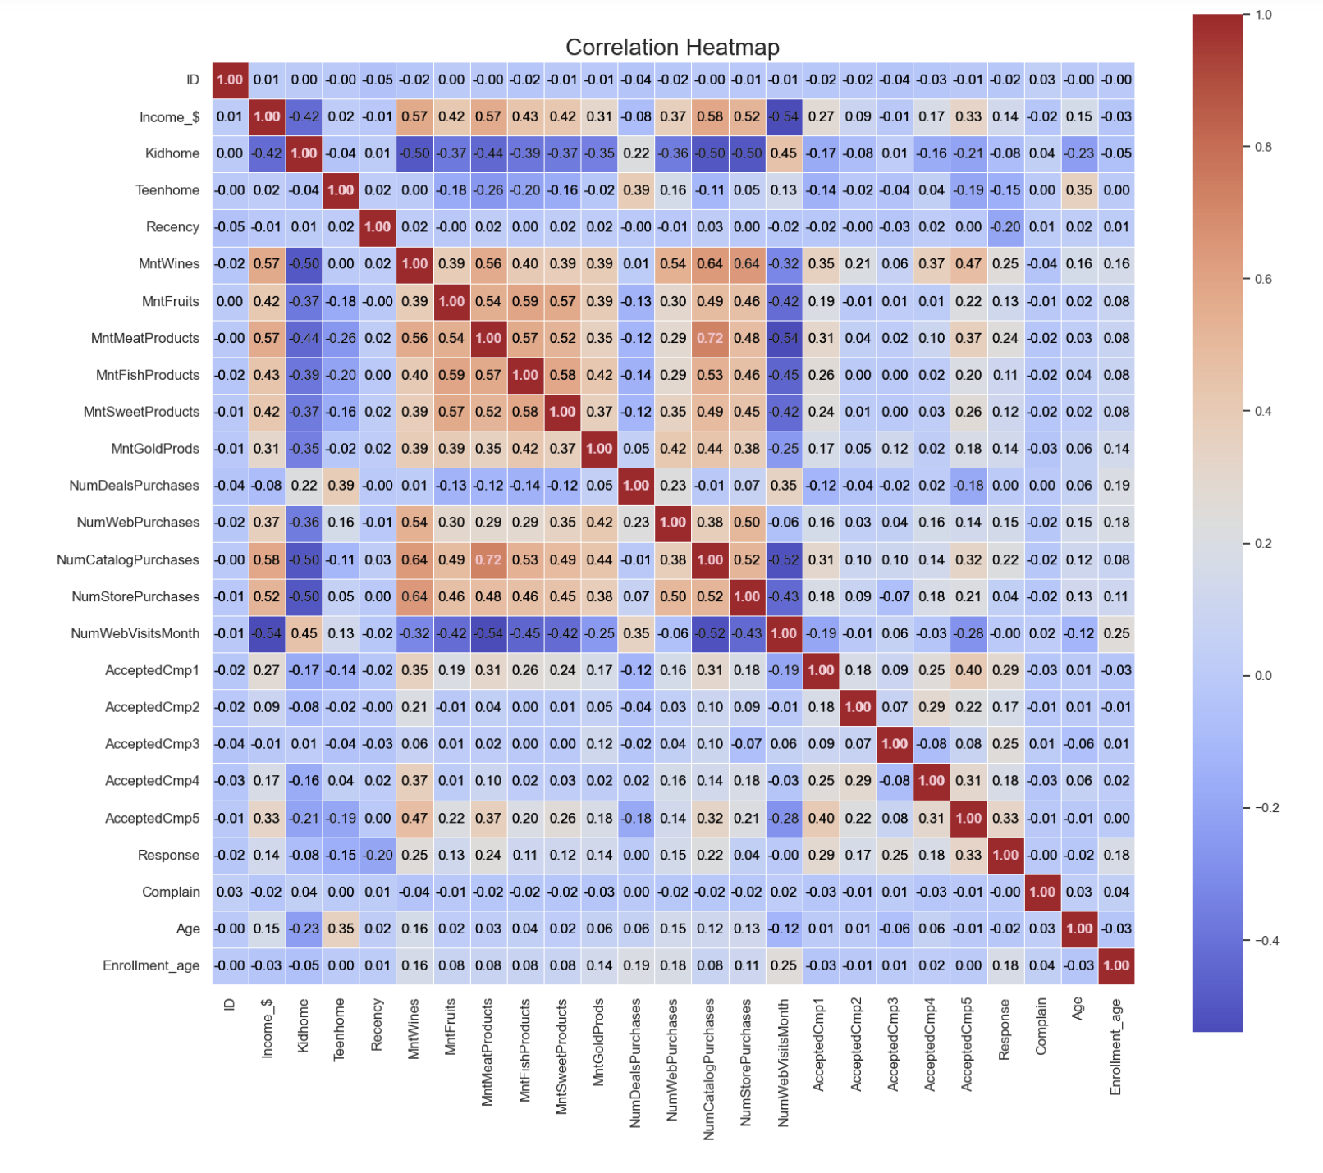
Plotting Heat Map.

Slide 61
Insights from Correlation Analysis with Response :
Age (0.02): There is a minimal positive correlation between the birth year and response.
Income (0.14): A positive correlation suggests higher income levels may influence response likelihood.
Kidhome (-0.08) & Teenhome (-0.15): Negative correlations indicate fewer children at home may slightly increase response rates.
Recency (-0.20): A negative correlation implies recent interactions may impact response positively.
MntWines (0.25), MntMeatProducts (0.24): Higher spending on wines and meat products shows a stronger positive correlation with response.
MntFruits (0.13), MntFishProducts (0.11), MntSweetProducts (0.12), MntGoldProds (0.14): Moderate positive correlations suggest preferences for these product categories may influence response.
NumWebPurchases (0.15), NumCatalogPurchases (0.22): Positive correlations indicate higher purchase activity, especially online and through catalogs, may lead to increased response rates.
AcceptedCmp1 (0.29), AcceptedCmp3 (0.25), AcceptedCmp5 (0.33): Strong positive correlations with specific marketing campaigns suggest their effectiveness in driving responses.

Slide 62
Important features as per correlation targeting ‘response’
AcceptedCmp2
NumWebPurchases
MntGoldProds
Income_$
MntFruits
MntSweetProducts
MntFishProducts
TeenHome
Recency
Response
AcceptedCmp5
AcceptedCmp1
AcceptedCmp3
MntWines
MntMeatProducts
NumCatalogPurchases
Enrollment_age
AcceptedCmp4

Slide 63
Converting Categorical Columns into desired format for applying ML Algorithm
One Hot Encoding:- One-hot encoding is a technique used in machine learning to convert categorical variables into binary vectors. It involves representing categorical values as binary vectors, where each category is mapped to an integer and then to a binary vector where only one bit is set to 1 (hot) while the rest are 0s. This method is crucial for converting categorical data into a numerical format that machine learning algorithms can process effectively. In Python, one-hot encoding can be implemented using libraries like Pandas or scikit-learn, providing a way to handle categorical data in machine learning models.

Slide 64
One hot Encoding :
Shape of encoded dataframe : (2240,42)
Separating Independent and Dependent (Target) Variables and Scaling it to same dimension
Covariance matrix :- It is a square matrix that displays the covariances between multiple variables, providing insights into how different variables are related in a dataset. It shows both the variances of individual variables and the covariances between pairs of variables. In Python, a covariance matrix can be created using functions like numpy.cov(), allowing for a comprehensive understanding of the relationships within a dataset.
Eigen Values :- Eigen values are scalar values that represent the scaling factor of eigen vectors when a linear transformation is applied to them. In Python, eigen values can be calculated using functions like numpy.linalg.eigvals() or numpy.linalg.eig(). They play a crucial role in various mathematical and computational applications, providing insights into the behavior of linear transformations and matrices.
Principal Component Analysis (PCA) :- It is a linear dimensionality reduction technique used in data analysis to extract essential information from high-dimensional datasets. It aims to preserve the most significant variations in the data while eliminating less important aspects.

Slide 65
Finding n_components using eigen values for Principal Component Analysis (PCA)
Applying Principal Component Analysis
Explained variance ratio is :
Component Income_$ - 0.15796265
Component KidHome - 0.05392993
Component TeenHome - 0.04543535
Component Recency - 0.04054654
Component MntWines - 0.03817715
Component MntFruits - 0.03674326
Component MntMeatProducts - 0.03488436
Component MntFishProducts - 0.03193598
Component MntSweetProducts - 0.02974051
Component MntGoldProds - 0.02912807
Component NumDealsPurchases - 0.02829924
Component NumWebPurchases - 0.02694884
Component NumCatalogPurchases - 0.02683588
Component NumStorePurchases - 0.02619135

Slide 66
Using Lazy Classifier to analyse each model and choose highly accurate
Lazy Classifier :- It is a tool provided by the Lazy Predict library in Python for machine learning tasks. It simplifies the process of building basic classification models without extensive coding. Lazy Classifier helps in quickly understanding which models perform better without the need for complex implementation. It is a valuable resource for streamlining the model selection process and gaining insights into the performance of various classification algorithms.

Slide 67
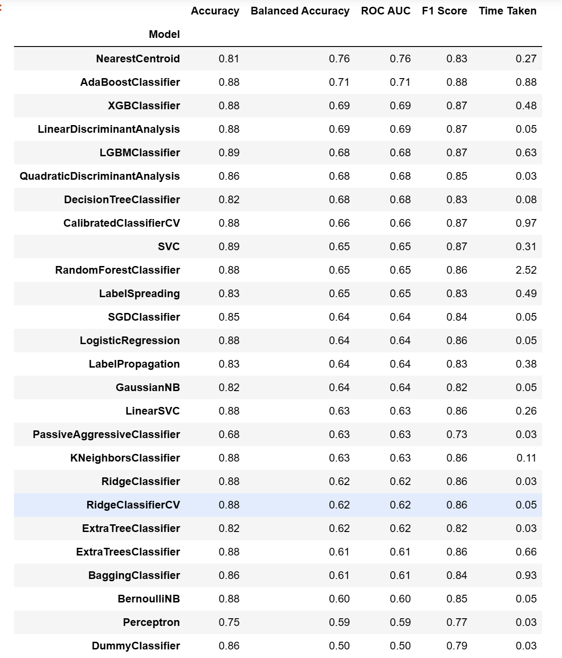
Seperated Train and Test data
After applying model to the data, the output is :

Slide 68
Logistic Regression Model
Logistic Regression :- It is a statistical method used for binary classification tasks, where the goal is to predict the probability of an event occurring based on input features. Unlike linear regression, which predicts continuous values, logistic regression predicts the probability that an instance belongs to a particular class (e.g., 0 or 1, Yes or No).
Precision :- Precision measures the proportion of true positive predictions among all positive predictions made by the model. It is calculated as the ratio of true positives to the sum of true positives and false positives.
Recall :- Recall, also known as sensitivity, calculates the proportion of true positive predictions among all actual positive instances in the dataset. It is computed as the ratio of true positives to the sum of true positives and false negatives.
F1 Score :- The F1 score is the harmonic mean of precision and recall, providing a balanced measure of a model's performance. It considers both false positives and false negatives, making it a useful metric for binary classification tasks.
Accuracy :- Accuracy represents the proportion of correct predictions made by the model over all predictions. It is calculated as the ratio of the number of correct predictions to the total number of predictions.
Macro Avg :- The macro average computes the unweighted mean of individual class metrics (precision, recall, F1 score), treating all classes equally. It is useful when all classes are of equal importance.
Weighted Avg :- The weighted average calculates the average of metrics, weighted by the number of instances in each class. It gives more weight to classes with more instances, making it suitable for imbalanced datasets.
Confusion Matrix :- A confusion matrix is a table that visualizes the performance of a classification model by comparing actual and predicted values. It shows the number of true positives, true negatives, false positives, and false negatives, providing insights into the model's performance across different classes.

Slide 69
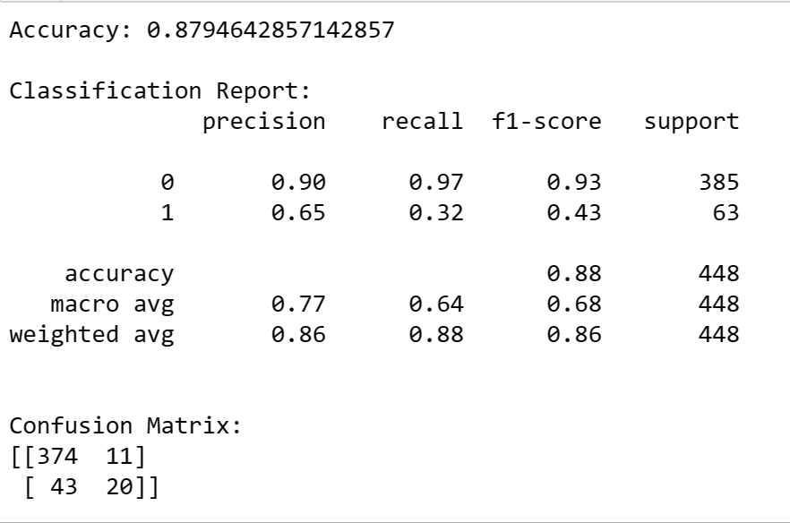

Slide 70
INSIGHTS :
Accuracy : The model achieved an accuracy of 0.879, indicating that it correctly predicted the class for approximately 88% of the instances.
Precision and Recall :
Class 0: The precision for class 0 is 0.90, suggesting that when the model predicted class 0, it was correct 90% of the time. The recall (true positive rate) for class 0 is 0.97, indicating that the model captured 97% of the actual class 0 instances.
Class 1: The precision for class 1 is 0.65, implying that the model correctly predicted class 1 65% of the time. The recall for class 1 is 0.32, showing that the model identified only 32% of the actual class 1 instances.
F1-Score : The weighted average F1-score is 0.86, which balances precision and recall for both classes.
Confusion Matrix :
True Positives (TP): 374 instances were correctly predicted as class 0, and 20 instances were correctly predicted as class 1.
False Positives (FP): 11 instances were incorrectly predicted as class 1.
False Negatives (FN): 43 instances were incorrectly predicted as class 0.
True Negatives (TN): 20 instances were correctly predicted as class 1.

Slide 71
Thank You

